Slide 1
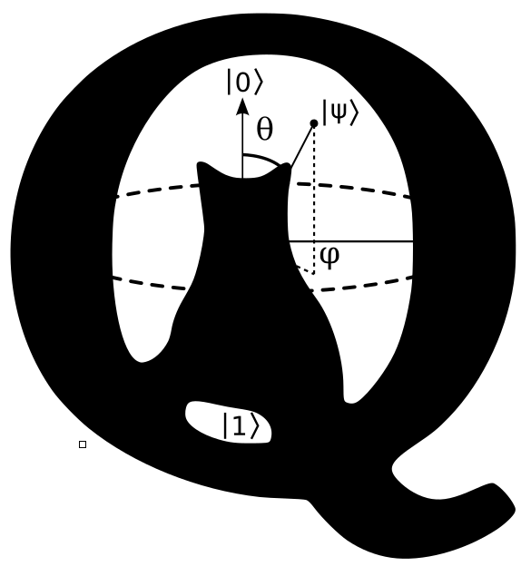
n dimensional Quantum Game of Life
0 < n <= 2
Daniel
Enrique
Xiang

Slide 2
First … let’s talk a bit about Conway’s Game of Life
Conway’s Game of Life is a cellular automaton.
… I mean, it is a two-dimensional orthogonal grid of square cells, each of which is in one of two possible states, alive or dead.
… ok, imagine a board (like a chess board) where each of the squares is a cell that might be dead or alive.

Slide 3
How do we decide if a cell is alive or dead?
By applying the following rules:
Any live cell with fewer than two live neighbours dies, as if by underpopulation.
Any live cell with two or three live neighbours lives on to the next generation.
Any live cell with more than three live neighbours dies, as if by overpopulation.
Any dead cell with exactly three live neighbours becomes a live cell, as if by reproduction.

Slide 4
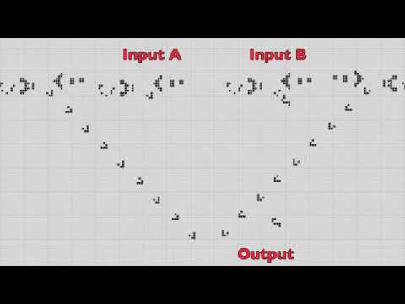
Yeah but why is it interesting?
Because GOL provides an example of emergence and self-organization …

Slide 5
Funny thing is ...
You do not necessarily have to use a board to code GOL, only one row (I mean one dimension) is enough
This is nice because this means we can code GOL with a single register
Then if you make this register quantum and put all the qubits in a superposition, you can produce all possible results in one execution … well, kind of.

Slide 6
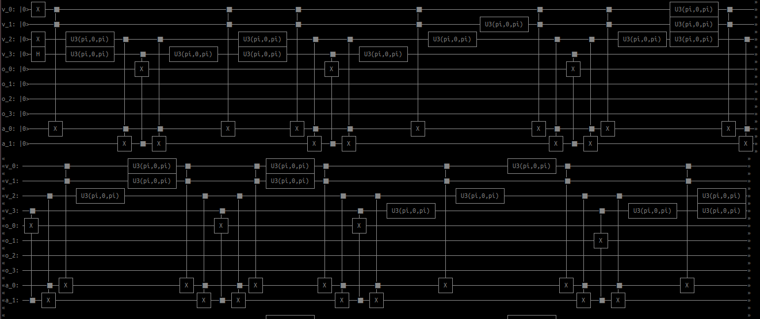
1D GOL - QRegister + OracleTruthTable

Slide 7

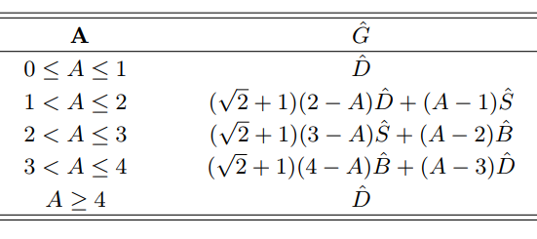
But even funnier ...
It is to code a 2D GOL with Quantum capabilities
We use a semi quantum kernel

Slide 8
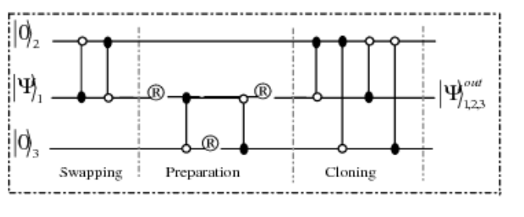
And we even go full quantum!
Kernel clones the cells - but they are imperfect copies - simulating mutation!

Slide 9
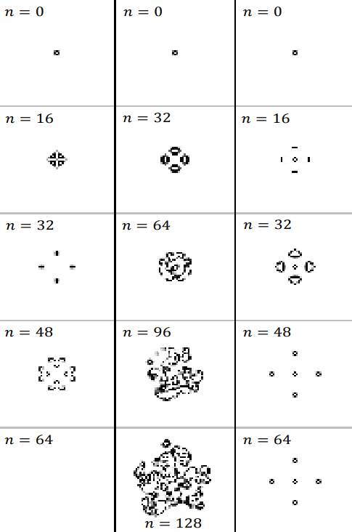
Gives rise to complex behaviour
Quantumness spreads through the system
You can see how much this affects the evolution
By changing the amount of initial superposition!

Slide 10
Thank you for listening and hosting us!

